Slide 1
HealthCare
Overview
Manoj D

Slide 2
Overview of Topics
Introduction to Health Insurance
Health Insurance Entities
Types of Health Insurance
Types of Health Plans
Provider Networks & Contracts
Benefit Plans & Policy Holders
Code Sets & Cost-Sharing
EDI Transactions
Medical Management Overview
Claims Life Cycle & Types
End-to-End Data Flow in Health Insurance

Slide 3
What is Health Insurance?
  Health insurance is a type of financial coverage that helps pay for medical and surgical expenses when you get sick, injured, or need treatment.
  This can include visits to doctors, hospital stays, surgeries, and other healthcare services.
  Importance:
  Access to Healthcare: Provides financial access to medical services.
  Financial Protection: Protects against high medical costs.
  Preventative Care: Encourages early treatment and prevention.

Slide 4
Health Insurance Entities
Member
Provider
Payer
A person covered by a health insurance plan, including the main policyholder and their family members.
A healthcare professional or facility that delivers medical services to patients.
The payer is the organization (insurance company or government program) that pays doctors, hospitals, or other healthcare providers for the services they give to members.

Slide 5
Health Insurance Entities
Member
  A member is an individual who holds a health insurance policy and Pay regular premiums to maintain coverage., which provides them coverage for medical services.
  Subscriber: The primary policyholder who owns the insurance plan
  Dependents: Family members (spouse, children) who are also covered under the subscriber’s health insurance policy.

Slide 6
Health Insurance Entities
Provider
Providers are healthcare professionals or institutions that deliver medical services to patients. This includes doctors, nurses, hospitals, clinics, and other healthcare facilities.
Role:
Providers are responsible for diagnosing, treating, and managing the health of insured members. They submit claims to the insurance company for payment of the services they offer.

Slide 7
Health Insurance Entities
Payer
  The payer is the organization, such as an insurance company or a government program, that pays healthcare providers for the medical services delivered to the insured member.
Role:
  The payer processes and reviews medical claims submitted by providers.
  They determine the amount to be paid to the provider based on the member's coverage, benefits, and the services provided.

Slide 8

Types of Health Insurance
Medicaid
Medicare
Commercial
Description: A public health insurance program designed for low-income individuals and families.
Eligibility: Available to those with limited income, including children, pregnant women, elderly individuals, and people with disabilities.
Description: A federal health insurance program primarily for individuals aged 65 and older, and certain younger people with disabilities
Eligibility: Open to people 65+ or younger individuals with qualifying disabilities
Description: Private health insurance typically provided through employers or purchased individually.
Eligibility: Available to individuals who do not qualify for Medicaid or Medicare; often offered as part of employee benefits.

Slide 9

Provider Networks and Contracts
Provider Network:
A group of healthcare providers (doctors, hospitals, clinics) that contract with an insurer to offer services at negotiated rates.
Types of Provider Network
Out-of-Network: Providers who do not have a contract with your insurance company.
In-Network: Providers that have a contract with your insurance company to offer services.

Slide 10
Types of Health Plans
HMO
PPO
Health Management Organisation
Preferred Provider Organisation
EPO
POS
Exclusive Provider
Organisation
Point of Service

Slide 11
Health Maintenance Organization
A health plan where members are required to select a primary care physician (PCP).
PCP acts as a gatekeeper for access to specialists and other services.
Key Features:
In-Network Care Only: Coverage is limited to providers in the plan’s network, except in emergencies.
Referrals Required: To see a specialist or receive specialized care, members need a referral from their PCP.
Advantages:
Lower Premiums.
Disadvantages:
Limited Provider Choice
Referral Requirement: Must go through the PCP for most specialist care, which can be time-consuming.

Slide 12
Preferred Provider Organization
A health plan that allows members to see any healthcare provider without needing a referral, though staying in-network is more cost-effective.
Key Features:
Flexibility in Provider Choice: Members can visit both in-network and out-of-network providers, with reduced costs for in-network care and higher cost of Out of network care.
No Referrals Needed: Members don’t need a primary care physician's referral to see specialists.
Advantages:
Greater Freedom.
Access to Out-of-Network Care
Disadvantages:
Higher Premiums.

Slide 13
Exclusive Provider Organization
A type of plan that provides coverage only for in-network providers except in emergency cases.
Key Features:
Exclusive Network Coverage: Members must use in-network providers to receive coverage, except in emergencies.
No Referrals Needed: Members can directly access specialists without a primary care referral.
Advantages:
Lower Premiums
No need to get referrals
Disadvantages:
No Out-of-Network Coverage
Limited Provider Choice

Slide 14
Point of Service
A hybrid health plan combining elements of HMO and PPO, offering both in-network and out-of-network care options.
Key Features:
Primary Care Physician (PCP) Requirement: Members typically need to select a PCP and get referrals for specialists.
Flexibility for Out-of-Network Care: You can go out-of-network, but you still need a referral from your PCP.
Advantages:
Flexibility in Choosing Providers
Cost Savings In-Network
Disadvantages:
Higher Costs for Out-of-Network Care.
Referral Requirements.

Slide 15
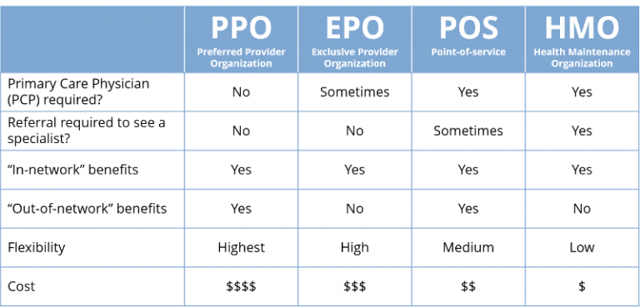

Slide 16
UNDERSTANDING BENEFITS PLAN AND POLICY HOLDER
BENEFITS PLAN
POLICY HOLDER
A benefit plan is a list of healthcare services covered by the insurance policy. It outlines the treatments, procedures, medications, and services that will be covered, along with the associated costs.
A policyholder is an individual or group that holds an insurance policy in their name, owning or controlling the policy and having the right to exercise the privileges specified in the contract.

Slide 17
Policy Holders
Subscriber
Member
The primary person who holds the health insurance policy, often the main policyholder responsible for the premiums.
An individual covered under the insurance policy, which may include the subscriber and any dependents.
Dependent
Family members (spouse, children) or other relatives who receive coverage under the subscriber’s health plan.

Slide 18
UNDERSTANDING CODE SETS
A code set in healthcare is a standardized list of codes used to represent specific data elements, such as medical diagnoses, procedures, and treatments.
Revenue Code
These are code used to identify the type of service or item provided by a healthcare facility
Procedure Codes
Describe the treatments or services provided to the patient.
Diagnosis Codes
Specify the type of injury or illness the patient has.

Slide 19
COST SHARING
Deductible
Copayment
Coinsurance
The out-of-pocket amount a member must pay before insurance begins to cover services
A fixed fee paid by the member for specific services (e.g. doctor visits, prescriptions).
A percentage of the cost that the member pays after meeting the deductible, with insurance covering the remaining portion

Slide 20
Electronic Data Interchange (EDI)
837
834
835
811
278
275
270 &271
276 & 277
EDI (Electronic Data Interchange) is a system that allows computer systems to exchange information. In healthcare, EDI provides a standardized format for sharing data between organizations such as hospitals, insurance companies, and government agencies.
Types of EDI

Slide 21
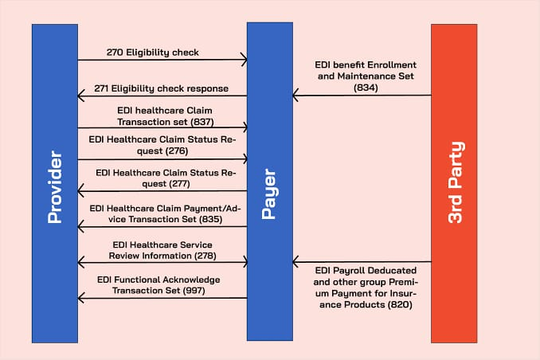


Slide 22
Types of EDI
837 (Claims Submission) : Used by healthcare providers to submit insurance claims for medical services provided to patients.
276/277 (Claims Status Inquiry and Response) : Inquires about the status of submitted claims and receives updates on claims processing.
270/271 (Eligibility Inquiry and Response) : Used by providers to verify a patient’s eligibility for healthcare benefits.
835 (Claim payment and Remittance Advice): Used by payers to send payment and adjustment information regarding the payment of claims.

Slide 23
Types of EDI
834 (Benefit Enrollment and Maintenance) : Used for enrolling and maintaining healthcare benefits for employees and dependents .
278 (Health Care Services Review) : Used for authorization requests or referral information for healthcare services before treatment is provided.
275 (Patient Information Reporting) : Used to provide detailed patient-specific information to insurers and providers, often for audit purposes.
811 (Detailed invoice) : A summary of all the charges for a patient’s care

Slide 24
Medical Management: Overview
Purpose:
Medical management ensures that healthcare services provided are medically necessary, appropriate, and cost-effective.
Types of Medical Management:
1. Utilization Management (UM):
Utilization Management is about ensuring necessary and cost-effective care
2. Care Management (CM):
Care Management is about coordinating and improving the overall care for patients.

Slide 25
Types of Medical Management:
Care Management (CM)
Utilization Management (UM)
Focuses on assisting patients with chronic conditions to improve health outcomes and reduce hospitalizations by coordinating care, offering guidance, and monitoring patient progress.
Reviews and approves healthcare services to ensure they are necessary and efficient, often involving pre-authorization, case reviews, and discharge planning.

Slide 26
Utilization Management (UM)
Prospective Review
Concurrent Review
A review done before you receive a medical service to ensure it's necessary and covered by insurance.
This takes place during your treatment. It's a way to monitor your care in real-time to ensure everything is going as planned and to make any necessary adjustments.
Retrospective Review
This occurs after you've received the service. It's a review of the treatment you received to check if it was appropriate and to evaluate the outcomes.

Slide 27
What is a Claim?
Definition:
A claim is a request made by a healthcare provider to an insurance company for payment for services provided to a patient.
Types of Claims:
Professional Claim
Dental Claim
Institutional Claim
Pharmacy Claim

Slide 28
Types of Claims
Professional Claims (CMS-1500)
Institutional Claims (UB-04):
Submitted by individual healthcare professionals doctors, physicians, and specialists for patient services.
Submitted by hospitals and healthcare facilities for inpatient or outpatient services.
Dental Claims :
Pharmacy Claims
Submitted by dentists for dental services.
Submitted by pharmacies for prescription medication reimbursement

Slide 29
Claims Life Cycle
1
3
2
4
Submission
Adjudication
The provider submits the claims to the payer
The review process where the insurer checks if the claim is eligible for payment based on coverage and policy rules.
Acquisition
Payment
Acquisition is the process where the insurance company receives and takes in a claim from a healthcare provider for services given to a patient.
The final step where the insurer either issues payment to the provider or denies the claim with a reason

Slide 30

End-to-End Data Flow in Health Insurance
Step 1
Step 2
Step 3
Step 4
Member
Provider
Claims
Payments
Step 5
Step 6
Data Repositories
Portals

Slide 31
End-to-End Data Flow in Health Insurance
1.Member (Individual Receiving Care)
→ (Receives healthcare services)
2. Provider (Healthcare Professional)
→ (Delivers care and submits claims)
3 .Claims
→ (Claim submitted by provider for services rendered)
4 .Payments
→ (Insurance or payer processes payment based on claims)
5. Data Repositories
→ (Claims and patient data stored securely)
6. Portals
→ (Member and provider access data and claim status)

Slide 32
Thank
You

